Slide 1
JS Weird Parts
18 May 18 | Start
19 May 18 | 1: 3-10
Appendix
Online

Slide 2
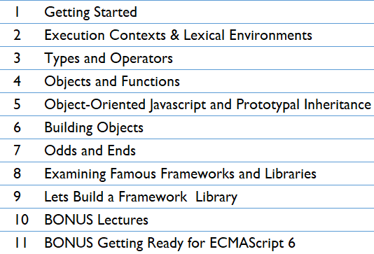
JS Weird Parts
Ch | Date
1 | 19 May 18
2
3
4
5
6
7
8
9
10
11
Udemy JavaScript, Weird Parts

Slide 3
1
Getting Started

Slide 4
Intro
Javascript is one of the most popular programming languages.
Some of the most important and wide used softwares is written using it.
It is
Deceptively powerful
Sometimes odd
Beautiful programming language
The goal of this course is to understand core Javascript – The Programming Language.
Agenda:
How Javascript works under the hood
Delve into advance concepts
Understand Javascript the way people who built jQuery understood Javascript

Slide 5
Javascript
Philosophy to learning code - Don’t imitate, Understand.
Deep understanding of the programming language – the Tool
Debug complex problems
Come up with innovative solutions
Read and understand code written by others
Tackle real-world problems with confidence

Slide 6
Setup
Tools Required
Browser: Google Chrome
Text Editor: Brackets.io
Use Browser tools – F12 Tools to debug

Slide 7
Big Words and JS
In Computer Science and Programming world, we use a lot of world that sounds complicated.
These actually describe some concepts not as scary as the term sounds.
Big Words refers to the Vocabulary of terms/concepts that needs special attention
I provide the definition of the term/concept
Explain the term
It’s just Vocabulary

Slide 8
Understandings, Framework & Weird Parts
Javascript – the programming language abstracts us from
How the computer works
How the browser works
How the server works
We need to understand how the tool is functioning in order to
Write advanced javascript code
Fundamental foundation knowledge paving way to understand advanced topics
The open-source community has developed a tremendous amount of frameworks and libraries such as:
jQuery
AngularJS
which provide us a lot of features to create advanced web applications.
However, a lot of people are introduced to Javascript via these frameworks rather than learn Javascript first.
All the frameworks are based on Javascript code
Included in applications
Written by developers capable of such mammoth task

Slide 9
Understandings, Framework & Weird Parts |
A developer without sound Javascript knowledge
Wouldn’t be able to understand the source code
It is due to the lack of deeper understanding of the Foundational language- JS
In order to build a robust, good Javascript application, one must be capable of
Opening up source code of jQuery
Understand the code
Build custom frameworks
Structure Javascript applications

Slide 10
Weird Parts
The weird parts of Javascript arise from the expectations of Programmers
Having experience in different programming languages
The weird parts are the most beautiful parts which make up the language – Javascript
Understand how’s and why’s
Understand the downside of certain programming structures

Slide 11
2
Execution Contexts and Lexical Environments

Slide 12
Conceptual Aside
Through out the course, we will have Asides – the concepts that are essential to understand topics coming ahead.
A conceptual aside is focused on a concept, an idea.
Here we consider three ideas:
Syntax Parsers
Execution Contexts
Lexical Environments

Slide 13
Syntax Parser
Syntax Parser is a program that reads your code and determines what it does and if its grammar is valid.
Your code isn’t magic. You are abstracted from the low-level details.
Someone else built programs to convert Javascript from the way its written to something the computer can understand.
These include
Compilers
Interpreters
Such programs are responsible for
Reading the source code written by programmer – character by character
Determine if the syntax is valid
Implementing the syntax in a way the computer can understand
Figure 2-1 shows the diagrammatic representation of processing the source code into computer instructions.
Your code is in human readable format
The interpreter, compilers convert your code into computer instructions which can be understood by the physical hardware

Slide 14
Syntax Parser |
The compiler allocates memory to the functions and variables which are part of our source code
Syntax parser is part of the compiler
Reads the source code char-by-char and translates it to machine code. Ex: f u n c t i o n and interprets it as keyword function
During the translation process, the programmers if they choose, they can add “Extra stuff”.
Along the way, the engine interpreting the code, can decide to do other things
The understanding of such delicate intricacies lead to deeper understanding of JS

Slide 15
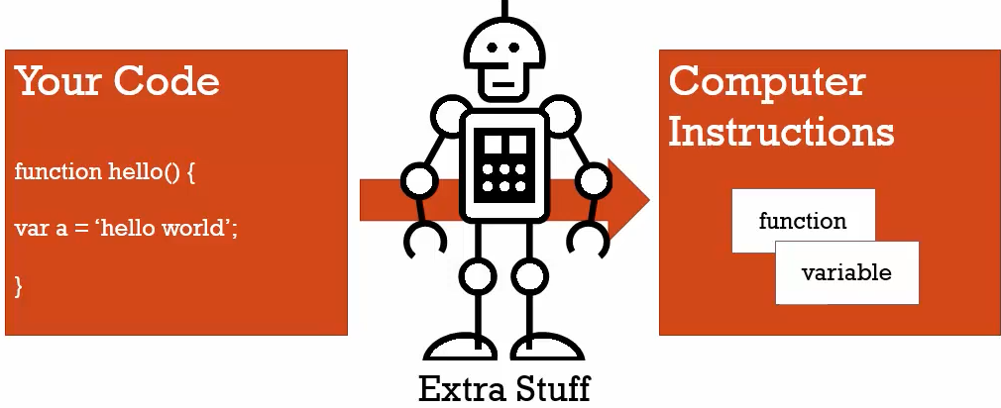
Figure 2-1

Slide 16
Lexical Environment
Lexical Environment is where something sits physically in the code you write.
‘Lexical’ means having to do with words or grammar.
A lexical environment exists in programming languages in which where you write something is important.
Its the syntax of the code.
Considering the code in Figure 2-1, the variable a sits inside the function hello( ).
That said, a sits lexically inside hello( ).
However, the intermediaries processing the code can add extra stuff
The lexical placement of code in source file gives an idea as to
Where the code will sit in the computer’s memory
How it will interact with other variables, functions, elements of the program
Lexical placement of code influences the Program – the compiler in
Cares where you place variables, function and other elements
Makes decisions to allocate memory

Slide 17
Lexical Environment |
Finally lexical environment boils down to 2 points:
Where its written
What surround it

Slide 18
Execution Context
Execution context is a wrapper to help manage the code that is running.
There are lots of lexical environments.
Areas of code that you are looking at physically
Which is currently running is managed via execution contexts.
Execution contexts contains the code that is being run.
It can contain things beyond what you’ve written in your code.

Slide 19
Conceptual Aside
Here we consider three ideas:
Name/Value pairs
Objects

Slide 20
The Global Environment, Global Object

Slide 21
Execution Context - Creating and Hoisting

Slide 24
3

Slide 25
Intro

Slide 26
4

Slide 27
Intro

Slide 28
5

Slide 29
Intro

Slide 30
6

Slide 31
Intro

Slide 32
7

Slide 33
Intro

Slide 34
8

Slide 35
Intro

Slide 36
9

Slide 37
Intro

Slide 38
10

Slide 39
Intro

